Slide 1

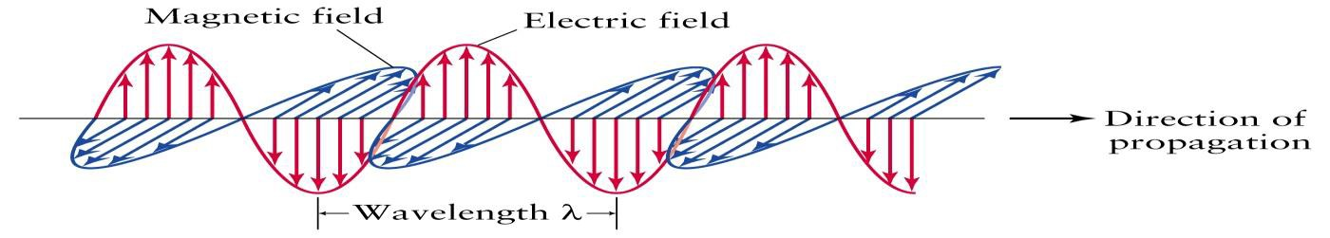
Dept. of Communication Engineering College of Engineering- University of Diyala Lecture No.: 1
3rd year Class
Antenna Theory and Design Lec. Jinan N. Shehab
Refrence:-
"Antenna and Wave Propagation ", Ashish Mathur, Ranjana Trivedi & Geetike B. Mathur.
" Electromagnetic Waves and Antennas", Sophocles J. Orfanidis.
"Antenna Theory Analysis and Design", Constantine A. Balanis.
"Antennas for All Applications" 3rd edition, John D. Kraus, Ronald J. Marhefka. 5- "Engineering Electromagnetics", 6th Edition ,William H. Hayt, John A. Buck.
1- Basic introduction to electromagnetic field:-
Wave:- can be defined as a motion (such as oscillation) through matter or free space.
An Electric field exists in the presence of a charged body.
A magnetic field is a force produced by a moving electric charge that exists around a magnet or in free space.
time-varying fields or waves are usually due to accelerated charges or time- varying current. Time-varying current →Electromagnetic fields (or waves)
- Electromagnetic (EM) radiation:- is an electric field that travels away from some
source ( like antenna, sun, radio tower....etc). Atraveling electric filed has associated magnetic field with it. Both these fields are perpendicular to each other and both are also perpendicular to the direction of wave propagation .
Amplitude
Fig(1) free space electromagnetic wave
  Electromagnetic waves spectrum:-
Continuous range of EM radiation from very short wavelengths (<300x10-9 m) (high energy) to very long wavelengths (cm, m, km) (low energy). Energy is related to wavelength (and hence frequency), EM waves characterized by:-
    Wavelength (λ) is the distance traveled by the energy during one cycle from crest to crest , usually expressed in metric units (meters, centimeters, etc.).
    frequency is the number of cycles repeated during unit time (usually 1 second) .
This is given in hertz (cycles per second). A kilohertz (kHz) is 1,000 cycles per second.
Note:- As frequency increases, wavelength becomes smaller. EM waves can be generated in different frequency bands: radio, microwave, infrared, visible, ultraviolet, x-rays, gamma rays.

Slide 2

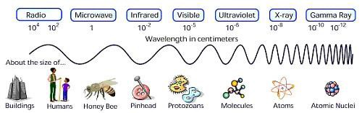
Dept. of Communication Engineering College of Engineering- University of Diyala Lecture No.: 1
3rd year Class
Antenna Theory and Design Lec. Jinan N. Shehab
Amplitude (A) (m):- The amplitude of the wave is represented by the length of the electrical vector at a maximum or minimum in the wave.
Velocity(v or C):- The velocity of a wave is defined as the multiplication of the frequency times the wavelength. This means:-
C=V = f λ in free space (vacuum) =V=C=3×10⁸ m/sec
One of the great discoveries in the history of electromagnetism is that electromagnetic waves travel at the speed of light (The velocity of light in vacuum is greater than its velocity in any other medium).
Fig.(2) electromagnetic Spectrum.
Band Abbreviation | Range of frequency | Range of wavelength
Audio frequency AF | 20 to 20,000 Hz | 15,000,000 to 15,000 m
Radio frequency RF | 10 kHz to 300,000 MHz | 30,000 m to 0.1 cm
Very low frequency VLF | 10 to 30 kHz | 30,000 to 10,000 m
Low frequency LF | 30 to 300 kHz | 10,000 to 1,000 m
Medium frequency MF | 300 to 3,000 kHz | 1,000 to 100 m
High frequency HF | 3 to 30 MHz | 100 to 10 m
Very high frequency VHF | 30 to 300 MHz | 10 to 1 m
Ultra high frequency UHF | 300 to 3,000 MHz | 100 to 10 cm
Super high frequency SHF | 3,000 to 30,000 MHz | 10 to 1 cm
Extremely high frequency EHF | 30,000 to 300,000 MHz | 1 to 0.1 cm
Heat and infrared* | 10⁶ to 3.9× 10⁸ MHz | 0.03 to 7.6× 10⁻⁵ cm
Visible spectrum* | 3.9× 10⁸ to 7.9× 10⁸ MHz | 7.6× 10⁻⁵ to 3.8× 10⁻⁵ cm
Ultraviolet* | 7.9× 10⁸ to 2.3× 10¹⁰ MHz | 3.8× 10⁻⁵ to 1.3× 10⁻⁶ cm
X-rays* | 2.0× 10⁹ to 3.0× 10¹³ MHz | 1.5× 10⁻⁵ to 1.0× 10⁻⁹ cm
Gamma rays* | 2.3× 10¹² to 3.0× 10¹⁴ MHz | 1.3× 10⁻⁸ to 1.0× 10⁻¹⁰ cm
Cosmic rays* | >4.8× 10¹⁵ MHz | <6.2× 10⁻¹² cm
Table (1) Electromagnetic spectrum. (* value approximate) 1-2 Radio frequency (RF)
any of the electromagnetic wave frequencies that lie in the range extending from below
3 kilohertz to about 300 gigahertz and that include the frequencies used for communications signals (as for radio and television broadcasting and cell-phone and
satellite transmissions) or radar signals.( RF have the longest wavelengths and lowest
frequencies of all the electromagnetic waves).
Radio propagation :- is the behavior of radio waves when they are transmitted, or propagated from one point on the earth to anther, or into various parts of the atmosphere.

Slide 3
Dept. of Communication Engineering College of Engineering- University of Diyala Lecture No.: 1
3rd year Class
Antenna Theory and Design Lec. Jinan N. Shehab
Like light waves, radio waves are affected by the phenomena of reflection, refraction, diffraction, absorption, polarization and scattering.
Band name | Abbreviation | Frequency and wavelength in air | Example uses
Tremendously low frequency | TLF | <3Hz > 100,000 km | ةيعانصلاو ةيعيبطلا ةيسيطانغمورهكلا ءاضوضلا
Extremely low | ELF | 3–30Hz | ةيئابرهكلا ةردقلا يف اضيا مدختسيو تاصاوغلا تلااصتا
frequency |  | 100,000 km – 10,000 km | ةيعمسلا تاددرتلاو زتره)50-60( ةبوانتملا
Super low frequency | SLF | 30–300Hz 10,000 km – 1000 km | تاصاوغلا تلااصتا
Ultra low frequency | ULF | 300–3000Hz 1000 km – 100 km | مجانملا تلااصتاو تاصاوغلا تلااصتا
Very low | VLF | 3–30kHz | ,ايكلسلا بلقلا تاضبن لدعم ةبقارم,تقولا طبض تاراشا ,ةحلاملا
frequency |  | 100 km – 10 km | ضرلاا مولع يفو ةديعب تافاسمل فارغلتلا تاطحم
Low frequency | LF | 30–300kHz 10 km – 1 km | يا( ةليوطلا تاجوملاو تقولا طبض تاراشا ,ةيحلاملا لعاشملا ايسا ءازجا ضعبو ابروا يف جماربلا ةعاذلال )ما
Medium | MF | 300–3000kHz | , ياواه ويدار , ةعاذلال ىدملا ةطسوتم )ما يا( ةجوم
frequency |  | 1 km – 100 m | .ئطاوشلا نفس تامدخو
High frequency | HF | 3–30MHz 100 m – 10 m | نزتس ةمزح كلذكو ويدارلا تاددرتو ةريصقلا تاجوملا يف ةديعب تافاسملو ىرخا ىلا ةطقن نم تلااصتلاا تامدخو .ةعاذلاا يف مدختسيو ةطسوتمو
Very high frequency | VHF | 30–300 MHz 10 m – 1 m | رادارلاو نويزفلتلا كلذكو ما فا ةمزح يف
Ultra high | UHF | 300–3000 MHz | ةكبش ,ةلاوجلا فتاوهلا ,ةيوركياملا نارفلاا ,نويزفلتلا يف
frequency |  | 1 m – 100 mm | .ثوتولب و)سيلرياولا( ةيلحملا يكلسلالا
Super high | SHF | 3–30 GHz | تاددرتو ,ةيعانصلا رامقلاا تلااصتا ,رادارلا ,كلفلا ملع
frequency |  | 100 mm – 10 mm | سيلرياولا ةكبش ,فيوركياملا
Extremely high | EHF | 30–300 GHz | حسام ,ةحلسلاا ةيجوت ,ةيلاعلا فيوركياملا تاددرت ,كلفلا ملع
frequency |  | 10 mm – 1 mm | يئوض
Terahertz or | THz or THF | 300–3,000 GHz | ,ةيبطلا تاقيبطتلا ضعب يف ةينيسلا ةعشلال ليدبلا ريوصتلا
Tremendously |  | 1 mm – 100 μm | تاددرتلاو ةمدقتملا ةحلسلاا ةمظناو دعب نع تاسسحتملا
high frequency |  |  | ةيلاعلا فيوركياملا
Table (2) radio wave spectrum.
1-3 The electrical properties of the transmission medium:-
The transmission media that are used to convey information can be classified as guided or unguided. Guided media provide a physical path along which the signals are
propagated; these include twisted pair, coaxial cable, and optical fiber. Unguided media
employ an antenna for transmitting through air, vacuum, or water, then the electrical properties of the transmission medium
a- Permittivity (ɛ) is the measure of the resistance that is encountered when forming an electric field in a medium. In other words, permittivity is a measure of how an electric field affects, and is affected by, a dielectric medium. The permittivity of a medium describes how much electric field (more correctly, flux) is 'generated' per unit charge in that medium. More electric flux exists in a medium with a high

Slide 4
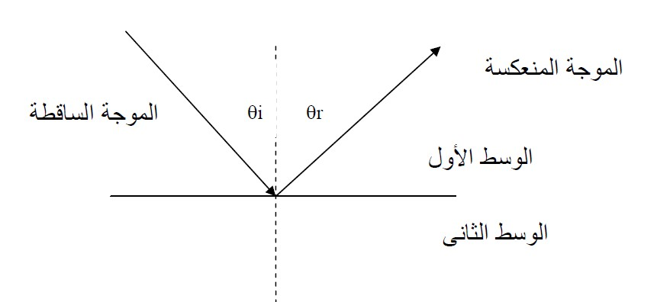




Dept. of Communication Engineering College of Engineering- University of Diyala Lecture No.: 1
3rd year Class
Antenna Theory and Design Lec. Jinan N. Shehab
permittivity (per unit charge) . each material has certain constant limits the value of permittivity and the permittivity is equal to:-
𝜀= 𝜀�𝜀�
Where:- ε0 = 8.8541878176.. × 10⁻¹² F/m is the vacuum permittivity.
εr is the relative permittivity of the material. This value is different from medium to anther and is equal to one in free space.
Permeability (µ) also called magnetic permeability, is a constant of proportionality that exists between magnetic induction and magnetic field intensity. The permeability is equal to:
𝜇= 𝜇₀𝜇�
Where:-
𝜇₀ is absolute permeability and is equal to 4π×10⁻⁷ H/m.
𝜇� is the relative permeability of the material. This value is different from medium to anther and is equal to one in free space.
Conductivity (σ) a measure of a material's ability to conduct an electric current.
Perfect dielectric has the conductivity is equal to zero approximately.
1-4 Optical properties of electromagnetic waves:- a- Reflection (bouncing)
When a radio wave propagating in one medium impinges upon another medium
having different electromagnetic properties, it will be partially reflected back into the first medium, and partially transmitted (refracted) into the second medium. The basic property of reflection is that the direction of the reflected wave is symmetric to the direction of the incident wave with respect to the surface normal. The rule for reflection is simply stated as:
θi=θr
Reflected wave
Incident wave
First medium
Second medium
Fig(3) Reflected wave

Slide 5
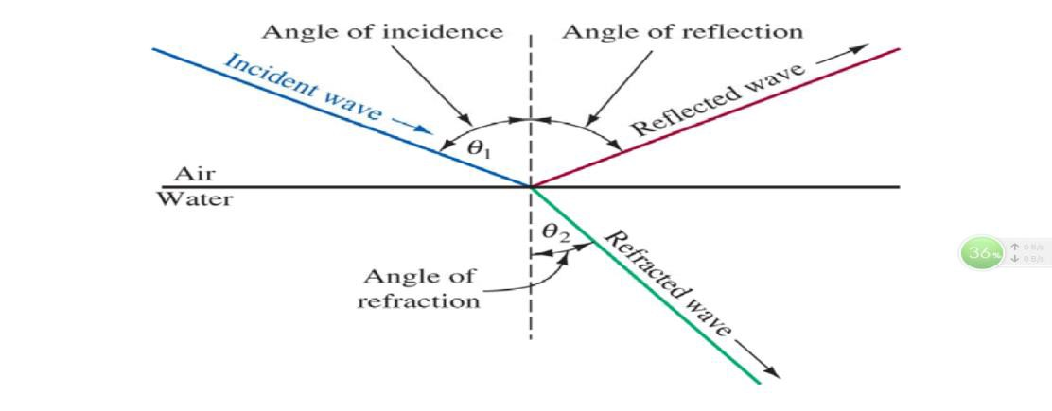
Dept. of Communication Engineering College of Engineering- University of Diyala Lecture No.: 1
3rd year Class
Antenna Theory and Design Lec. Jinan N. Shehab
b- Refraction (Banding)
Refraction occurs when waves pass from one density medium to another with different velocities of propagation.The amount of bending or refraction that occurs at the interface
of two materials of different densities is quite predictable and depends on the refractive
index which is simply the ratio of the velocity of propagation in a given material (EM wave propagate at the speed of light in a vacuum, in other mediums like air or glass, the speed of propagation is slower).
_{� =} � � � � � �� � ���� �� �𝒂 �� �� ₌ �
����� �� ����� �� ����� ������ ��
The Snell's law connect the relation between the incident wave in the 1st medium and the refracted wave in the second medium
n1 sin 𝜃₁ = �2 sin 𝜃₂
n1= refractive index of first medium. n2= refractive index of second medium.
Θ1= the incident angle. Θ2= the refracted angle.
Note:- if the incident medium has a lower index of refraction then the reflected wave has a 180º phase shift upon reflection. Conversely, if the if the incident medium has a large index of refraction then the reflected wave has no phase shift.
c- Diffraction (scattring)
Scattering (diffraction) is a general interaction process between electromagnetic waves and various objects. Small and irregularly shaped objects, such as trees, lamp posts, street signs or irregularities in building walls are considered as scatterers. The building materials (steel, wire meshes, and plasterboards) cause scattering that in turn causes
signal energy to be reradiated in many different directions.
d- Interference (colliding)
Radio wave interference occurs when two or more eleclromagnetic waves combine in such away to occupy the same position in space using the principle of linear superposition.

Slide 6
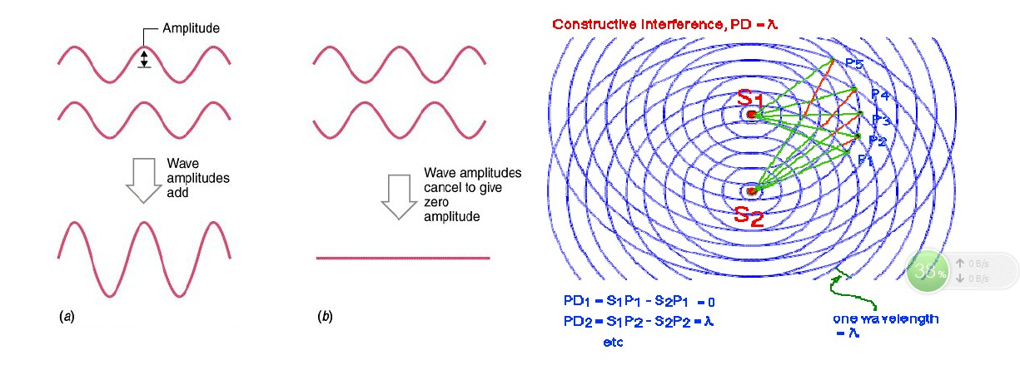
Dept. of Communication Engineering College of Engineering- University of Diyala Lecture No.: 1
3rd year Class
Antenna Theory and Design Lec. Jinan N. Shehab
Absorption
is the loss of signal power as the signal moves through the transmission medium, and that reduces the available bandwidth. The following two materials are considered the
largest absorption for microwaves:-
  Metals: the electrons in the metals can moving freely through the metal, and then these electrons can swinging and absorbed the electromagnetic waves that pass through the metal.
  Water: the electromagnetic waves in the water causes jostling the particulars of the water about the electromagnetic waves, and then result in absorption the energy of
these waves.
2- Time varying Maxwell's Equation's:-
Maxwell’s equations describe all (classical) electromagnetic phenomena:-
Differential (or Point) Form | Integral Form | Remarks
∇ × �̅ = − 𝜕�̅ 𝜕� | 𝜕 ∮ �. �� = − 𝜕� ∫ �. �� | �������′� ���
𝜕�̅ ∇ × �̅ = 𝐽�̅ + 𝜕� | ∮ �. �� = ∫ 𝐽. �� | �����′� ���
∇. �̅ = 𝜌� | ∮ �. �� = ∫ 𝜌�. �� | �����′� ��� ��� ������𝑖� �𝑖���
∇. �̅ = 0 | ∮ �. �� = 0 | �����′� ��� ��� ������𝑖� �𝑖���
Where:-
H = magnetic field (A/m). | E = electric field (V/m).
B = magnetic flux density(wb/m²) or Tesla , B=µH | D = electric flux density, (C/m²) = ɛE
(𝜕B/𝜕t) = time-derivative of magnetic flux density | (𝜕D/𝜕t) = displacement electric current density (A/m²)=Jd.

Slide 7
Dept. of Communication Engineering College of Engineering- University of Diyala Lecture No.: 1
3rd year Class
Antenna Theory and Design Lec. Jinan N. Shehab
𝜌� = volume charge density (C/m³)
JT = conduction current density (A/m 2) =Jcond+JSou = 𝜎�+J, J= source current
1- Faraday's Law:-
Michael Faraday discovered that the induced Vemf (in volts), in any closed circuit is equal to the time rate of change of the magnetic flux linkage by the circuit:-
�. �. � = − ��[����′� ���] �� �. �. � = −� ��
(1)
�� ��
Lenz’s rule gives the direction of the induced emf which states that the induced current produced in a circuit always in such a direction that it opposes the change or the cause that produces it.
ψ is the Magnetic Flux within a circuit.
e.m.f is the electro-motive force, which is basically a voltage source.
The total magnetic flux is simply the integral (or sum) of the B field over the area enclosed by the wire:
ψ=ʃ� 𝑩. ��
� = ∫ �. ��
��
� = ��
�. �. �_{���𝑎�} = ∮ �. ��
(�)
(3)
(4)
(5)
From stokes theorem which can be used to transform the line integral to the surface integral of curl:-
∮ �. �� = ∫ ∇ × �. �� [������ �ℎ�����]
�����𝑖���𝑖�� �����𝑖��� (2)& (6)𝑖� �����𝑖�� (1):-
�
∫ ∇ × �. �� = − �� ∫ � . ��
It follows that:-
𝜕�
∇ × � = − 𝜕�
Which is the differential form of Faraday's Law.
(6)
(7)
(8)
2- Amper's Law:-
For static EM fields, we recall that:-
𝛁× 𝑯= 𝑱
(�)
But the divergence of the curl of any vector field is identically zero:
𝛁. (𝛁× 𝑯) = � = 𝛁. 𝑱
The continuity of current requires that:
(�)

Slide 8
Dept. of Communication Engineering College of Engineering- University of Diyala Lecture No.: 1
3rd year Class
Antenna Theory and Design Lec. Jinan N. Shehab
𝝏𝝆�
𝛁. 𝑱= − 𝝏� ≠ �
(�)
Thus eqs. 2 and 3 are obviously incompatible for time-varying conditions. We must modify eq. 1 to agree with eq. 3. To do this, we add a term to eq. 1, so that it becomes:
𝛁× 𝑯= 𝑱+ 𝑱�
(�)
where Jd is to be determined and defined. Again, the divergence of the curl of any vector is zero. Hence:
𝛁. (𝛁× 𝑯) = � = 𝛁. 𝑱+ 𝛁. 𝑱�
In order for eq. 5 to agree with eq. 3:
(�)
𝛁. 𝑱� = −𝛁. 𝑱→ 𝛁. 𝑱� =
𝝏�
𝝏𝝆�
𝝏𝝏�
𝝏�
= 𝝏� (𝛁. �) = 𝛁. 𝝏�
(�)
��
𝑱� = 𝝏�
Substituting eq. 6 into eq. 3 results in:
𝜕�
𝜵× � = 𝐽+ 𝜕�
This is Maxwell's equation (based on Ampere's circuit law) for a time-varying field. The term Jd = əD/ət is known as displacement current density and J is the conduction and source current density (J =σ E+J).
3- Poynting Vector and Flow of Power:-
Poynting was the developer and eponym of the Poynting vector, which describes the direction and magnitude of electromagnetic energy flow and is used in the Poynting
theorem, a statement about energy conservation for electric and magnetic fields, This relation can be obtained from Maxwell's equation as follows:-
𝛁× �̅ = − 𝜕�̅ ∇ × �̅ = 𝐽̅ + 𝜕�̅
��� (1)
𝜕� 𝜕�
Multiply the above equations by dot E and dot H, from these we obtain:-
�̅. (∇ × �̅) = −�̅. 𝜕�̅
���
�̅. (∇ × �̅) = 𝐽.̅ �̅ + �̅. 𝜕�̅
(2)
Subtract following vector identity:-
𝜕� 𝜕�
�̅. (∇ × �̅) − �̅. (∇ × �̅) = ∇. (�̅ × �̅)
We then have:-
(3)
∇. (�̅ × �̅) = −𝐽. �̅ − −�̅. 𝜕�̅ − �̅. 𝜕�̅
(4)
𝜕� 𝜕�
Next, assume that Ohm's Law applies for the electric current:-
𝐽= 𝜎�̅
(5)
∇. (�̅ × �̅) = −𝜎(�̅. �̅) − −�̅. 𝜕�̅ − �̅. 𝜕�̅
(6(�))
𝜕� 𝜕�
or ∇. (�̅ × �̅) = −𝜎|�|² − �̅. 𝜕�̅ − �̅. 𝜕�̅
(6(�))
𝜕�
𝜕�

Slide 9
Dept. of Communication Engineering College of Engineering- University of Diyala Lecture No.: 1
3rd year Class
Antenna Theory and Design Lec. Jinan N. Shehab
From calculus (chain rule), we have that:-
𝜕
𝜕
(�̅. �̅) (7)
�̅. 𝜕�̅ = 𝜀(�̅. 𝜕�̅) = 𝜀¹ (�̅. �̅) ��� �̅. 𝜕�̅ = 𝜇(�̅. 𝜕�̅) = 𝜇¹
𝜕� 𝜕� 2 𝜕� 𝜕� 𝜕�
2 𝜕�
Hence, we have;-
𝜕
𝜕
∇. (�̅ × �̅) = −𝜎|�|² − 𝜇¹ (�̅. �̅) − 𝜀¹ (�̅. �̅)
(8(�))
2 𝜕� 2 𝜕�
Final differential (point) form of the Poynting theorem:
∇. (�̅ × �̅) = −𝜎|�|² − 𝜕(¹ 𝜇|�|²) − 𝜕(¹ 𝜀|�|²)
(8(�))
𝜕� 2 𝜕� 2
Volume (integral) form (over volume V):-
1
(9)
∫ ∇ . (�̅ × �̅). �� = − ∫ 𝜎|�|². �� − ∫ 𝜕( 𝜇|�|²) . �� − ∫ 𝜕(¹ 𝜀|�|²)
2
𝜕� 𝜕� 2
Using divergence theorem, the last term can be change from avolume integral to a surface integral over the surface S surrounding V, then Final volume form of Poynting theorem:-
1 1
(10)
∮. (�̅ × �̅). �� = − ∫ 𝜎|�|². �� − ∫ 𝜕( 𝜇|�|²) . �� − ∫ 𝜕( 𝜀|�|²) . ��
2 2
For a stationary surface:
𝜕� 𝜕�
1 1
∮. (�̅ × �̅). �� = − ∫ 𝜎|�|². �� − 𝜕∫( ( 𝜇|�|²)). �� − 𝜕∫( ( 𝜀|�|²)). ��
(11)
2 2
𝜕� 𝜕�
Power dissipation as heat (Joule's law)
Rate of change of stored magnetic energy
Rate of change of stored electric energy
Right-hand side = power flowing into the volume of space.
∮. (�̅ × �̅). �� =power flowing out of the region.
− ∮( (�̅ × �̅). �� =power flowing into the region.
Define the Poynting vector: �⃗ = �⃗⃗ × �⃗⃗ W/m².
The Vector S = E X H has interpreted as representing the amount of field energy passing through the unit area of surface in unit time normally to the direction of flow of energy. This statement is termed as Poynting’s theorem and the vector S is called Poynting Vector. The direction of flow of energy is perpendicular to vectors E and H
4- Instantaneous, Average, and Complex Poynting vector:-
The time-dependent power flow density of an electromagnetic waveis given by the instantaneous Poynting vector
�⃗⃗⃗�⃗�⃗⃗⃗�⃗�⃗ = �⃗⃗ × �⃗⃗

Slide 10
Dept. of Communication Engineering College of Engineering- University of Diyala Lecture No.: 1
3rd year Class
Antenna Theory and Design Lec. Jinan N. Shehab
Consider time-harmonic fields represented in terms of their phasors:-
�⃗⃗⃗�⃗�⃗⃗⃗�⃗�⃗ = �⃗⃗ × �⃗⃗
�(�) = ��(� ���� ) =
�(�) = ��(� ���� ) =
(1)
(2�)
1
[����� _{+ �}∗�−��� ]
2
1
2
[����� _{+ �}∗�−��� ]
(2�)
�⃗⃗⃗�⃗�⃗⃗⃗�⃗�⃗ ₌
Let :-
1 1
∗ ∗ �2��
∗
∗ −�2��
[� × � + � × �] + [� × �� 4 4
+ � × � �
]
(3)
� = � × �∗
� = � × �
Then :-
and �∗ = (� × �∗)∗ = �∗ × �
and �∗ = (� × �)∗ = �∗ × �∗
�⃗⃗⃗�⃗�⃗⃗⃗�⃗�⃗ ₌
�⃗⃗⃗�⃗�⃗⃗⃗�⃗�⃗ ₌
�𝑎�� ⁼
1 1
∗ �2�� ∗ −�2��
]
(4)
[� + � ] + [�� + � � 4 4
1 1
�2��
₂ ��(�) + ₂ ��[�� ]
(5)
1
𝑇
� ∫ ����� ��
(6)
0
𝑇
𝑇
1 1
1 1
∗ �2��
�𝑎�� ⁼
� ∫ ₂ ��(� × � )�� + � ∫ ₂ ��(� × �) � ��
(7)
0 0
𝑇
1 1
�𝑎�� ⁼
∗
(8)
��(� × � ) + ��(� × �) ∫ cos(2��) �� 2 2�
1
0
∗
�_{𝑎��} = ₂ ��(� × � )
1
�𝑎�� ⁼ ₂ ^{��(�}���� ⁾
Where:-
(9)
(10)
1
∗
���� = ₂ (� × � )
Scom is the complex poynting vector.

